Slide 1
B9DA111 SSRS Reporting Project Stock Price Analysis Using SSRS
LECTURER : Suman Gurbani Group : Delvin Vallooran Jose(20039903 : Eldhose thelakkattu Benny(20044108) : Muhammed Mukhsith Thekke Mattara (20040105)

Slide 2
Project overview
Objective: Bulid a BI pipeline to analyze and visualize stock price trends for Microsoft , meta and Tesla Tools and technologies : Python (pandas): Data cleaning & preprocessing of raw stack CSVs. Sql server: Data storage via star schema design. SSIS : ETL process for loading cleaned dat into SQL Dta warehouse. SSRS : Report generation (tabular matrix ,drill,down, sub-reports ,parametarized). Tableau: Advanced Visualisations (line chart, heat map, Dashboard). Neo4J: Graph data base for company relationship.

Slide 3
Key deliverables
Data cleaning and structuring using python Star schema Design for analytical Querying End to End ETL pipeline using SSIS Multiple report types in SSRS Visual Dashboards in Tablaue Graph modeling in Neo4j.

Slide 4
Data cleaning
:
Objective Clean and standardize stock data for Microsoft (MSFT), Meta (META), and Tesla (TSLA) before loading into the data warehouse. Steps performed : Function definition Read raw CSVs , skipping metadata rows Parses and formats the ‘Date’ column Adds extra fields : Data keys, compoany name, ticker, market and currency Select revelant columns for currency Expoert clraned files: Saved cleaned files as *_CLEANED.csv for MSFT, META, and TSLA Final merge for fact table: Merges cleaned files into a unified dataset

Slide 5
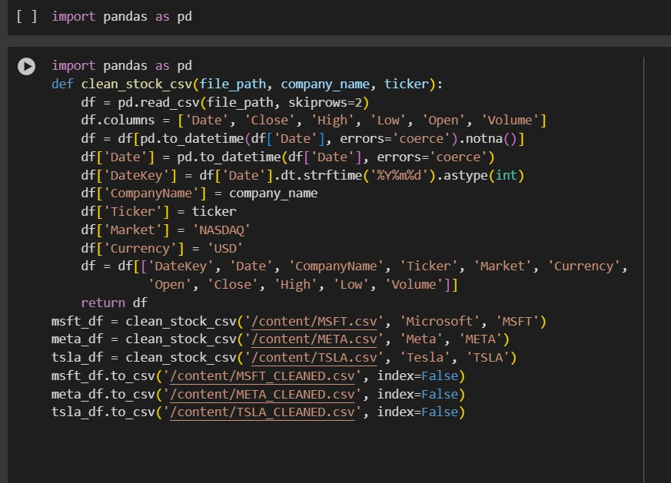
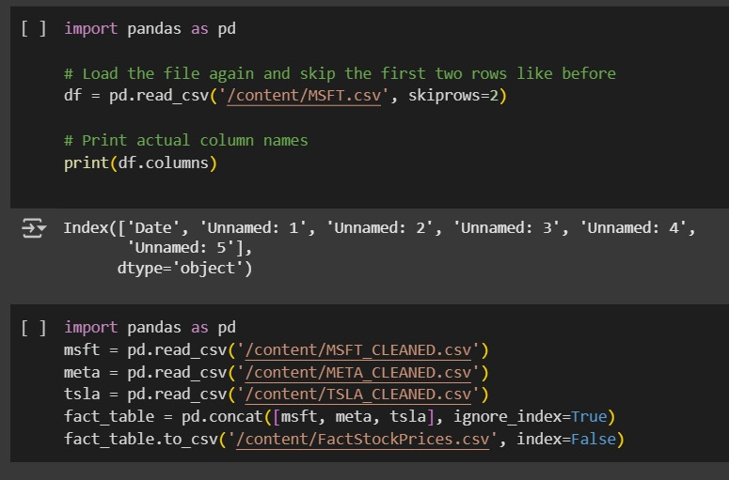

Slide 6
Star schema Design for analytical Querying
Diagram Overview: The schema is based on a star design, with one central Fact Table and multiple Dimension Tables. This structure supports efficient querying, reporting, and OLAP operations (e.g., in SSRS, Power BI). Fact Table - FactStockPricesContains numerical measures such as: OpenPrice, ClosePrice, HighPrice, LowPrice, Volume
Linked to all dimension tables using foreign keys: CompanyKey, DateKey, MarketKey, CurrencyKey, PriceTypeKey
Dimension Tables: DimCompany: Company name, ticker, sector, country
DimDate: Full date, year, month (ideal for time-series filtering)
DimMarket: Market name and region
DimCurrency: Currency code and description
DimPriceType: Type of price (e.g., open, close, adjusted)

Slide 7
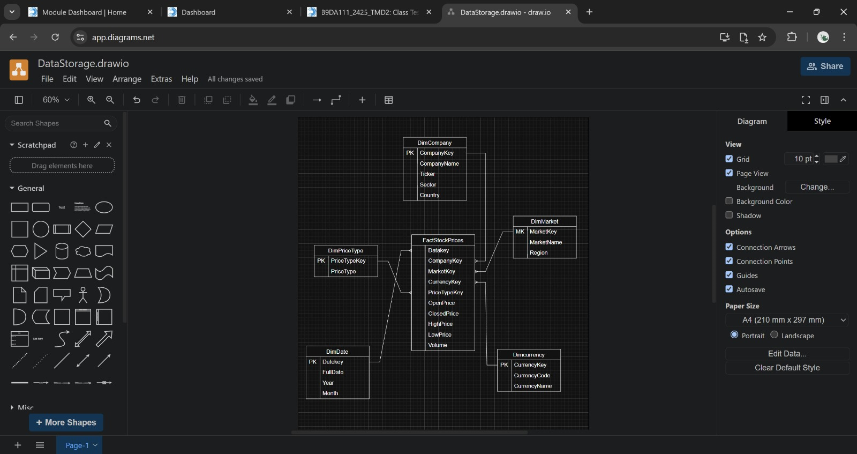

Slide 8
End to End ETL pipeline using SSIS
:
Step 1: Creating the DatabaseWe created a new SQL data warehouse database named StockDW using: sql, Copy, Edit, CREATE DATABASE StockDW;
Step 2: Creating Dimension Tables
Dimension tables store descriptive attributes: DimCompany: Company name, ticker, sector, country
DimDate: Full date with breakdowns (year, quarter, month, etc.)DimMarket: Market name and region
DimCurrency: Currency name and codeDimPriceType: Pricing category (open, close, etc.)
Each table has a primary key to link to the fact table
Step 3: Creating the Fact Table
The central table is FactStockPrices
Stores measurable data: OpenPrice, ClosePrice, HighPrice, LowPrice, Volume
Foreign keys reference each dimension: CompanyKey, DateKey, MarketKey, etc.

Slide 9
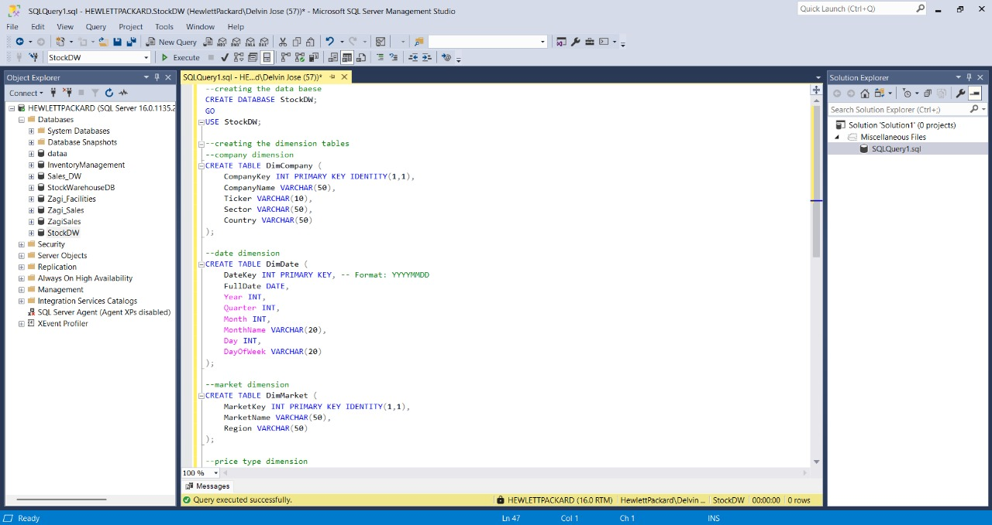
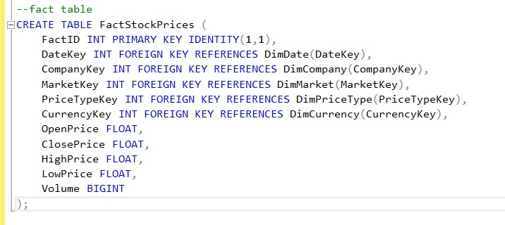

Slide 10
Data Insertion and Validation
Overview: This slide covers the process of inserting data into the dimension and fact tables within the StockDW data warehouse, establishing relationships, and verifying the correctness of data.
Key Steps:
Insert Sample Data into Dimension Tables: Example: DimCompany was populated with companies such as Microsoft, Meta, and Tesla.
Each record includes attributes like CompanyName, Ticker, Sector, and Country.
Generate and Populate Date Dimension: Used a SQL loop to insert rows from 2010 to 2030.
Extracted columns: FullDate, Year, Month, Quarter, Day, DayOfWeek, etc.
Link Fact Table with Dimension Tables: ALTER TABLE statements were used to create foreign key constraints from FactStockPrices to all dimension tables.
This enforces referential integrity and completes the star schema structure.
Validation via SELECT Queries: Ran SELECT TOP 5 queries for all dimension tables to confirm data insertion.
Verified records in DimCompany, DimMarket, DimCurrency, DimPriceType, and DimDate

Slide 12
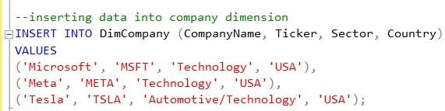
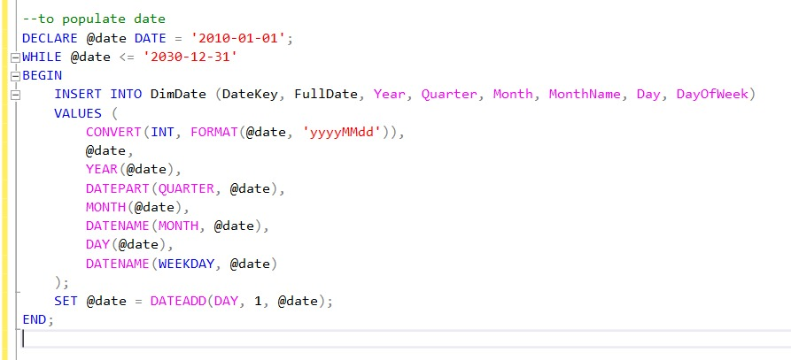
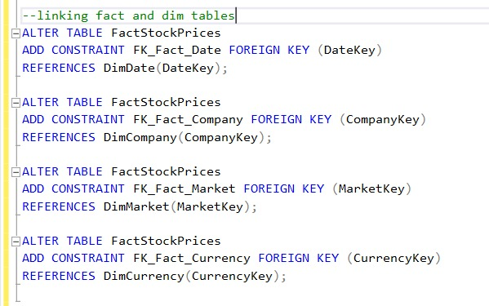
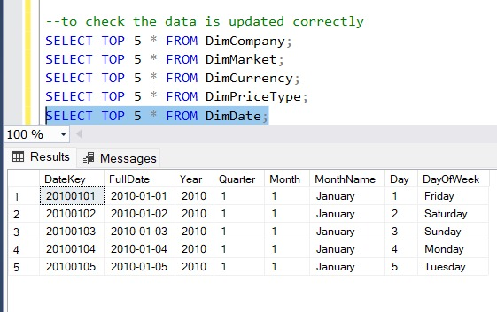

Slide 13
ETL Process and Data Loading into Fact Table
Overview: This slide explains how we used SSIS (SQL Server Integration Services) to extract, transform, and load (ETL) data from a flat file into the FactStockPrices table of the StockDW data warehouse.
ETL Workflow (SSIS):Flat File Source: Reads data from a structured .csv file.
Data Conversions: Converts column formats and ensures compatibility with SQL schema.
Lookups: Fetches matching CompanyKey, MarketKey, CurrencyKey, and DateKey values from dimension tables based on text descriptions.
OLE DB Destination: Loads the fully transformed data into the FactStockPrices table.
Column Mapping: Mapped fields include OpenPrice, ClosePrice, HighPrice, LowPrice, Volume, and foreign keys for all dimension tables.
Ensured correct relationships by matching dimension values with their respective surrogate keys.
Validation in SSMS: After execution, we queried the FactStockPrices table to confirm successful data insertion. We also validated that dimension keys were resolved correctly and data types matched.
Sample records from DimCompany, DimMarket, DimCurrency, and DimDate confirm relational integrity.

Slide 14
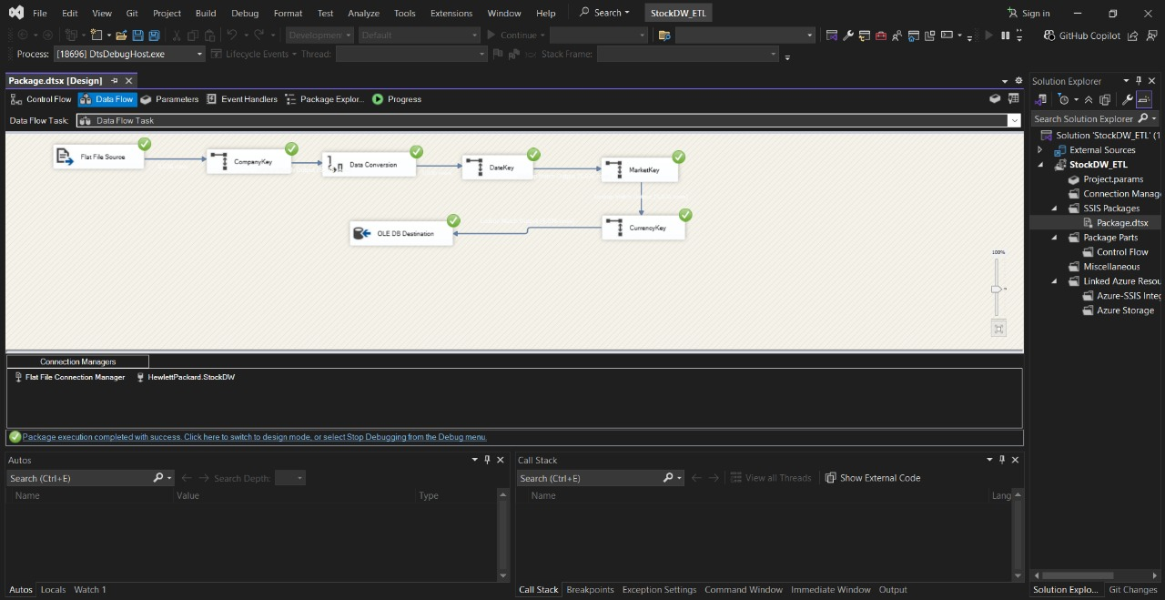
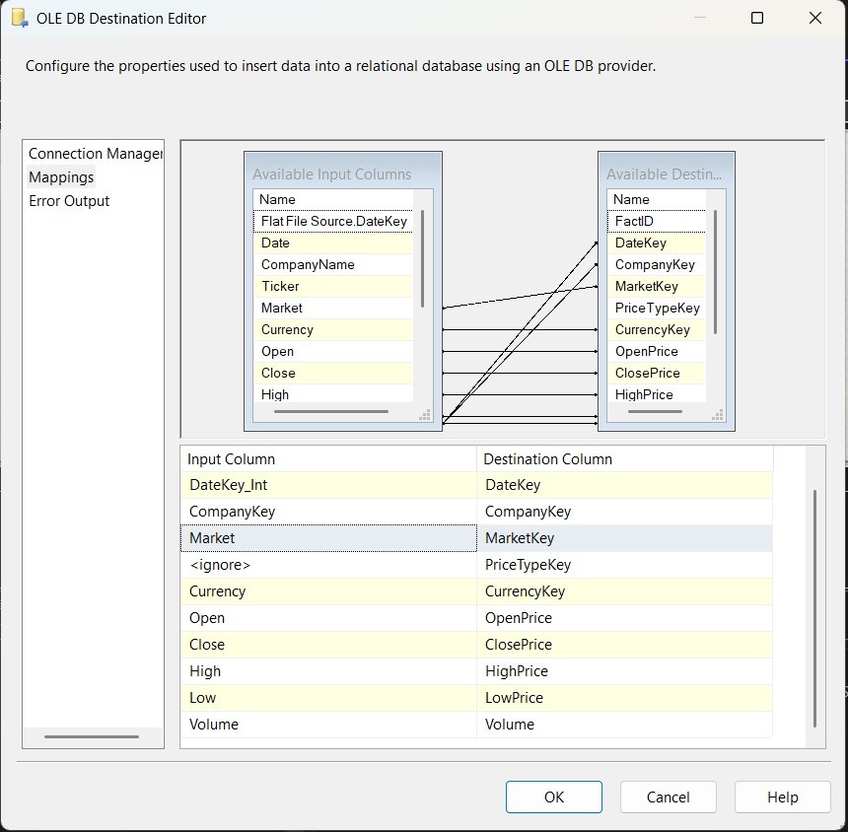
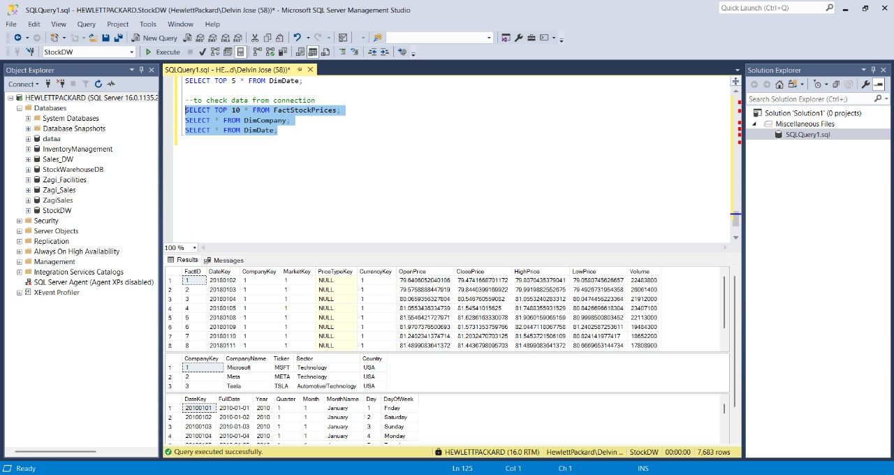

Slide 15
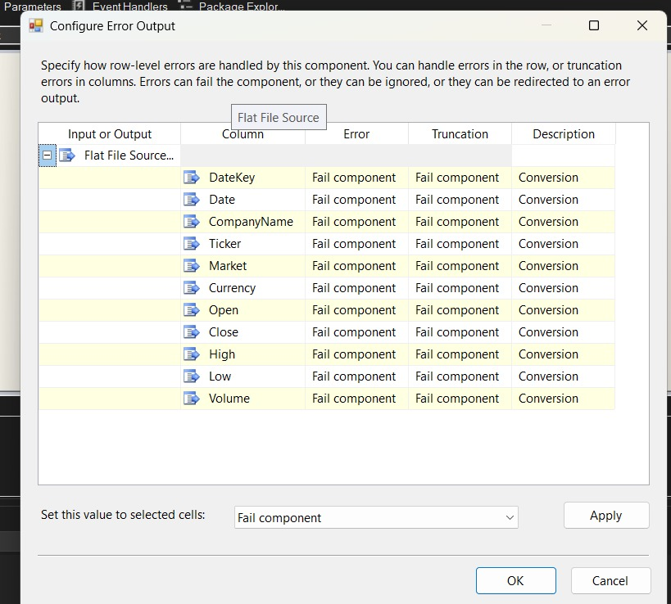
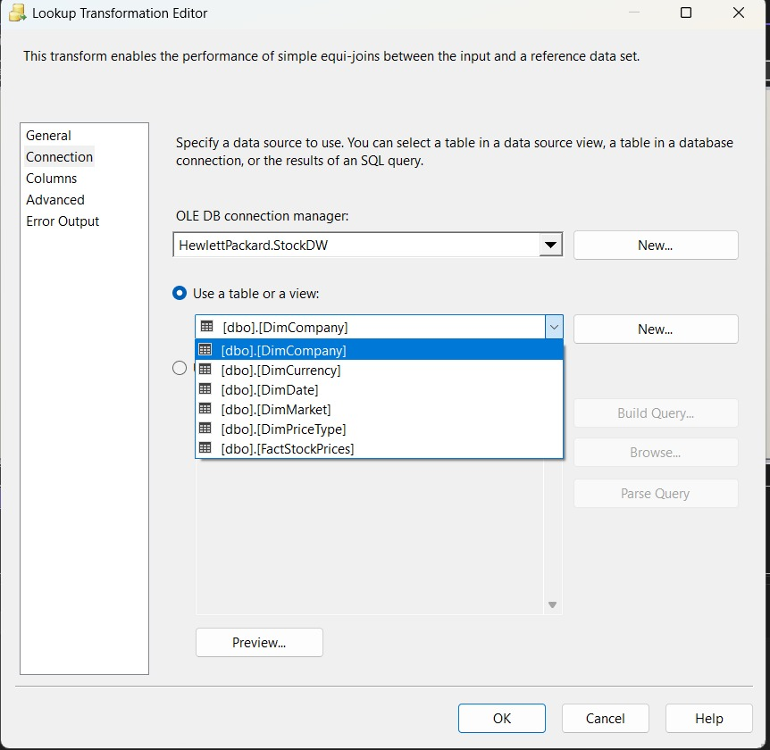

Slide 16
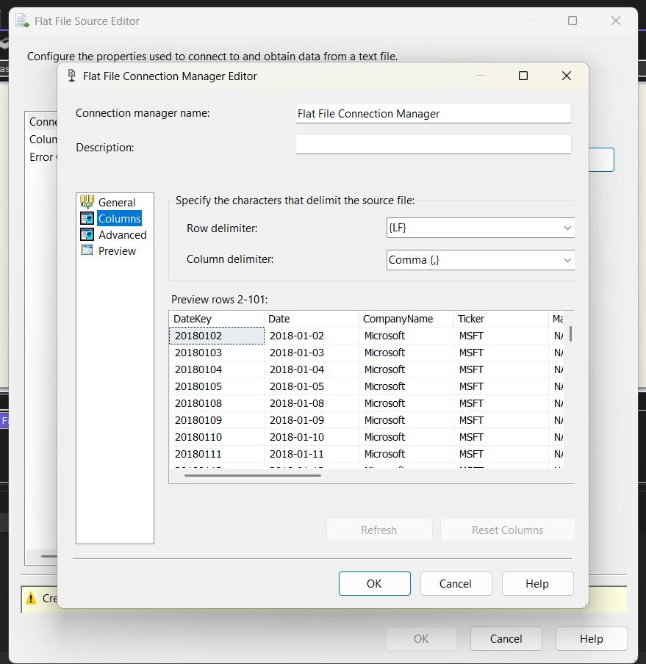

Slide 17
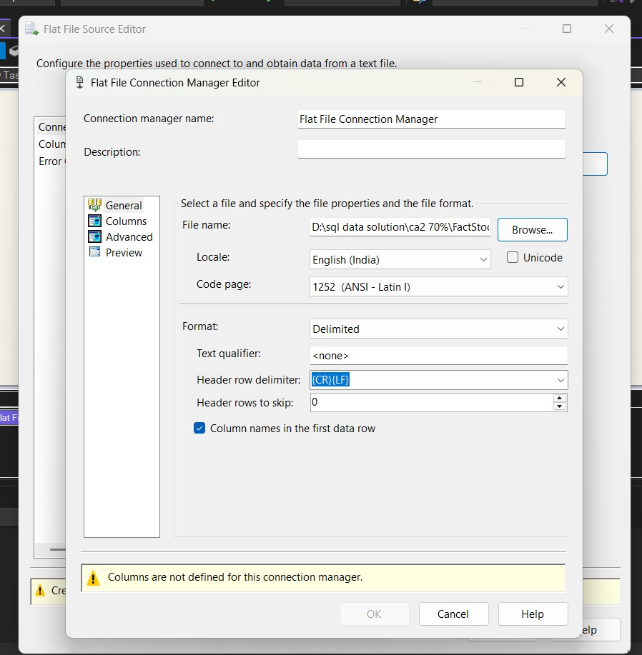

Slide 18
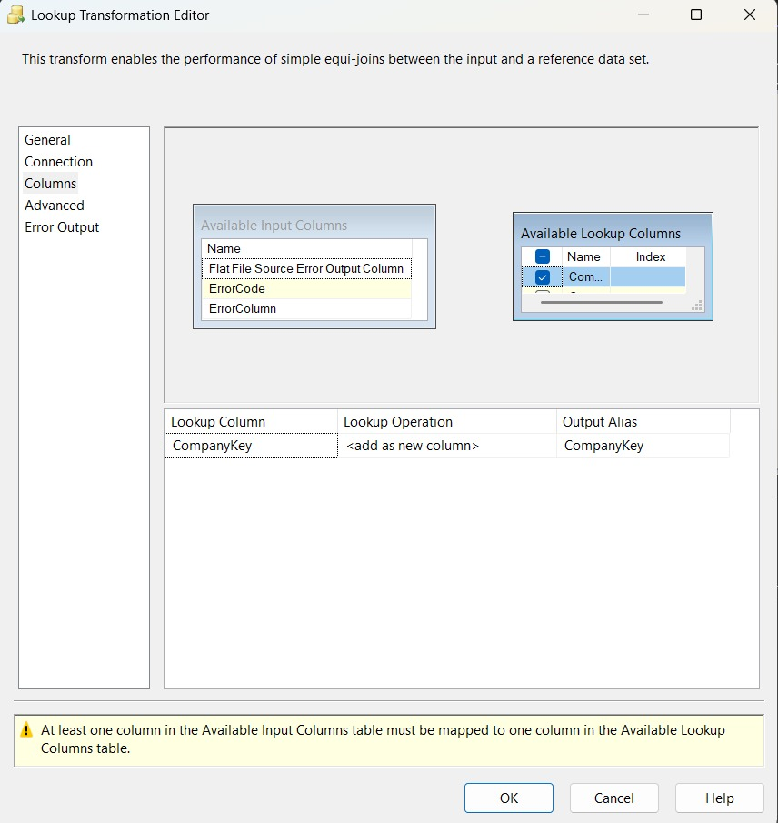

Slide 19
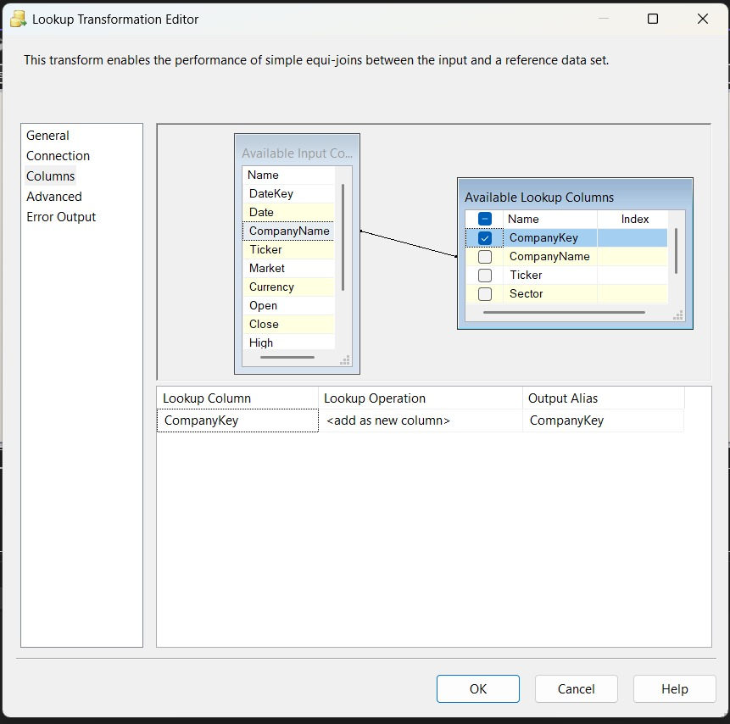

Slide 20
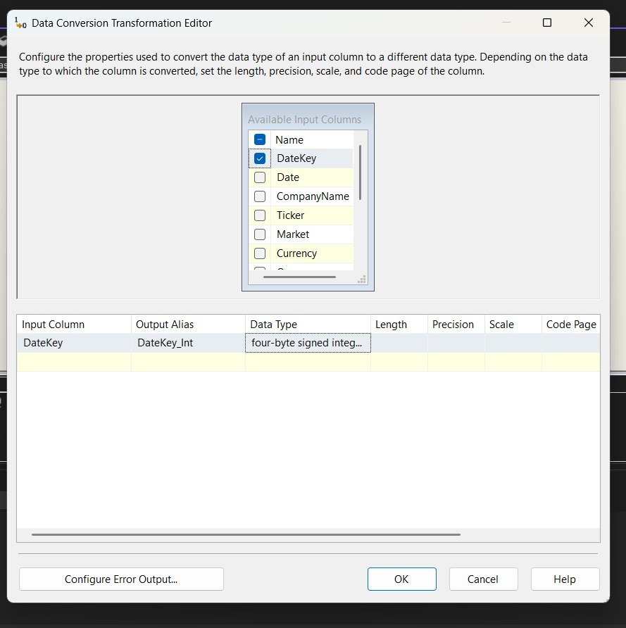

Slide 21
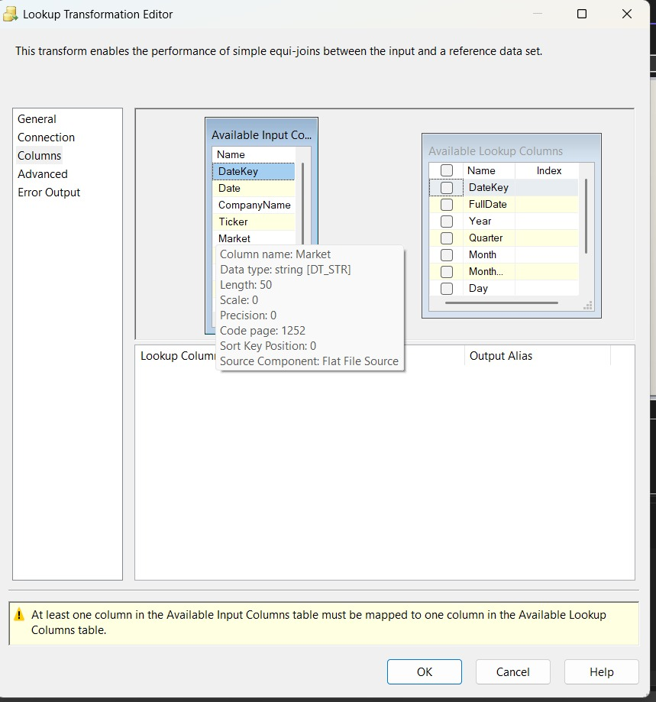

Slide 22
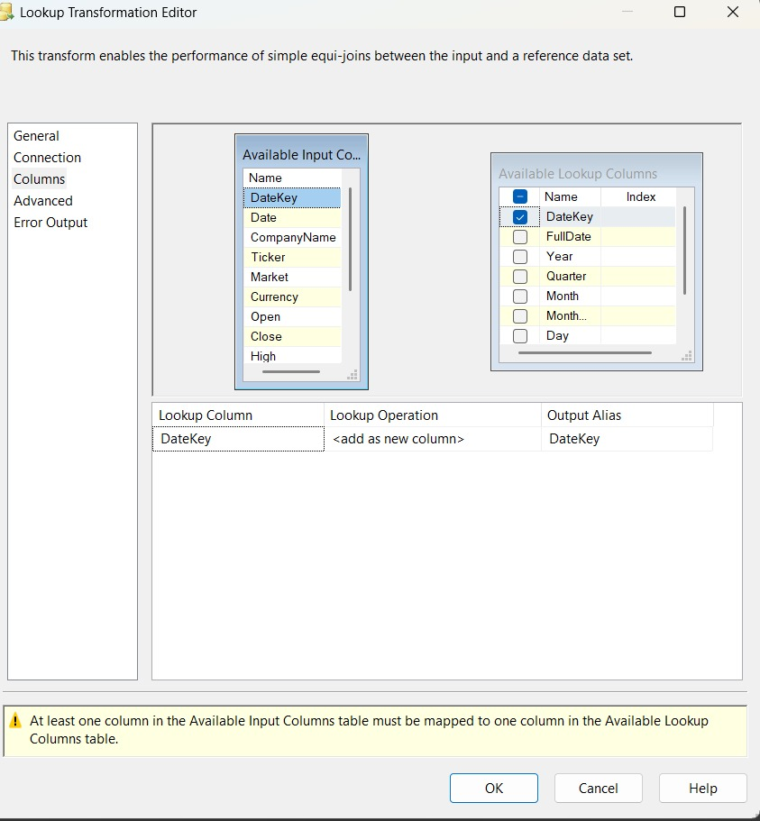

Slide 23
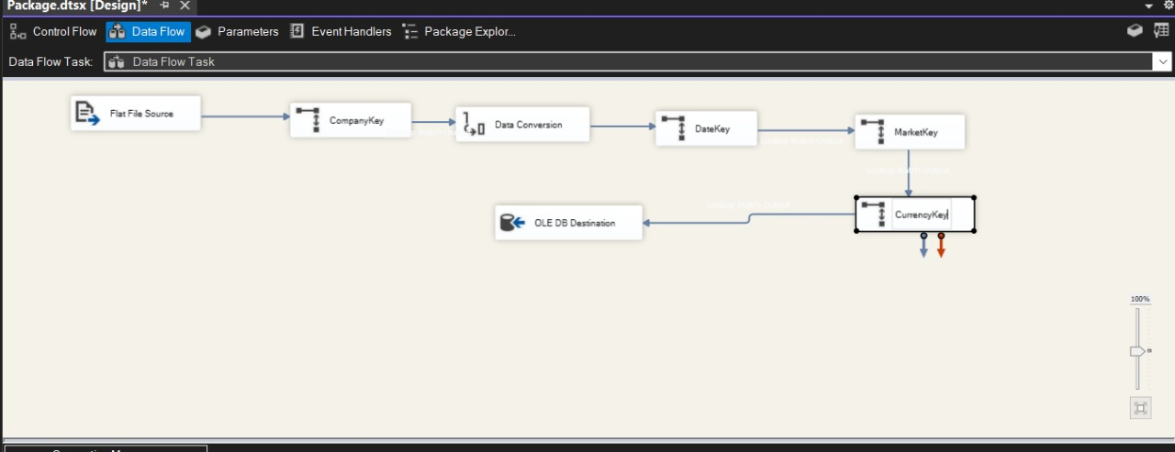

Slide 24
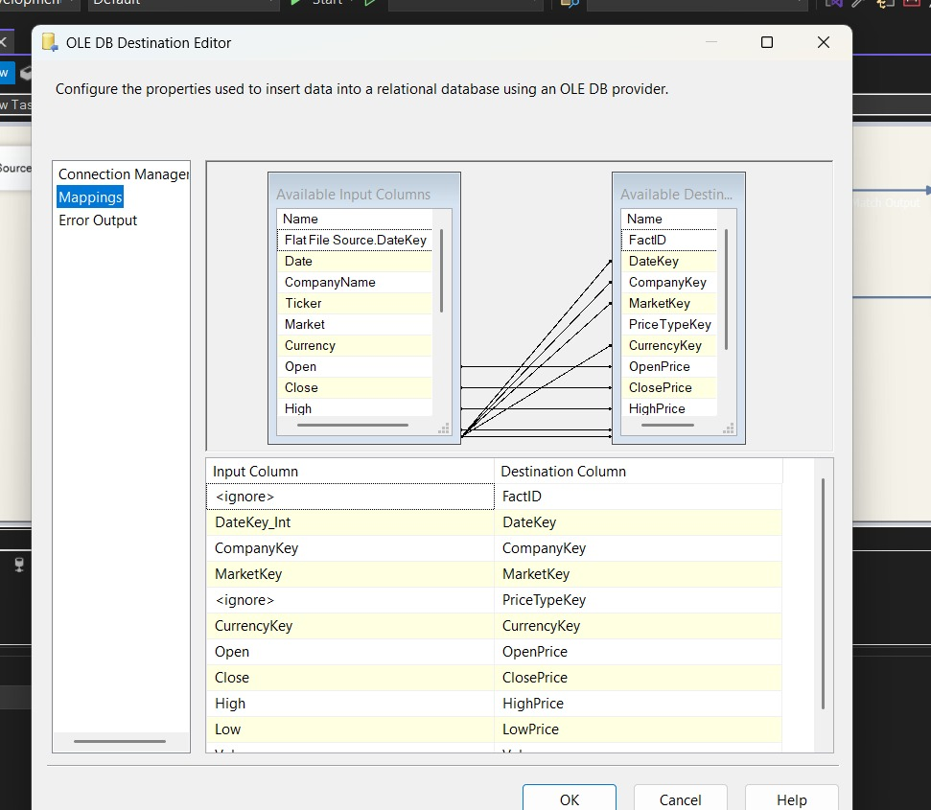

Slide 25
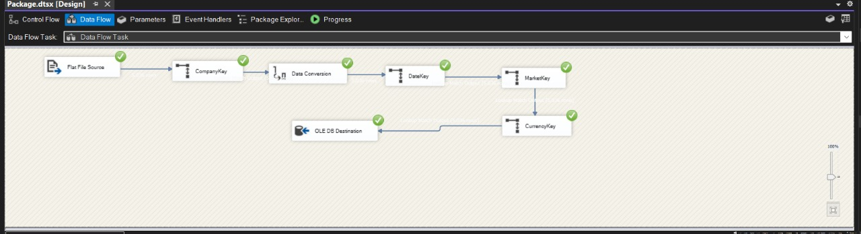

Slide 26
SSRS Report Visualizations
This slide showcases the different types of reports we created using SQL Server Reporting Services (SSRS) to visualize and interact with the stock market data stored in our data warehouse.
SSRS Reports Developed: Tabular Report
Displays raw data in a structured row-column format. Used for detailed stock entries.
Matrix Report
Dynamic pivot-style view of stock prices by date, company, or currency.
Useful for comparing metrics across multiple dimensions.
Drill-down Report
Enables users to expand and collapse grouped data (e.g., by region or sector).
Helps simplify complex data views.
Parameterized Report: Allows user input to filter data (e.g., by company name, year, or market).
Increases interactivity and user customization.
Subreport (StockDetails)
Linked with main reports to provide more detailed insight.
Example: clicking on a stock name shows historical prices.

Slide 27
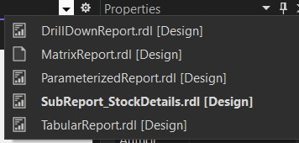

Slide 28
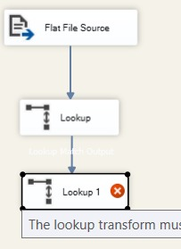
error

Slide 29
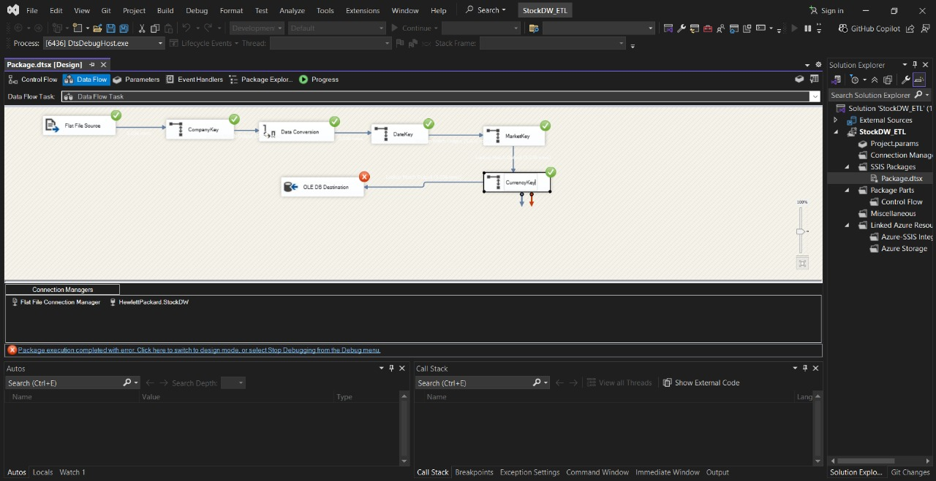

Slide 31
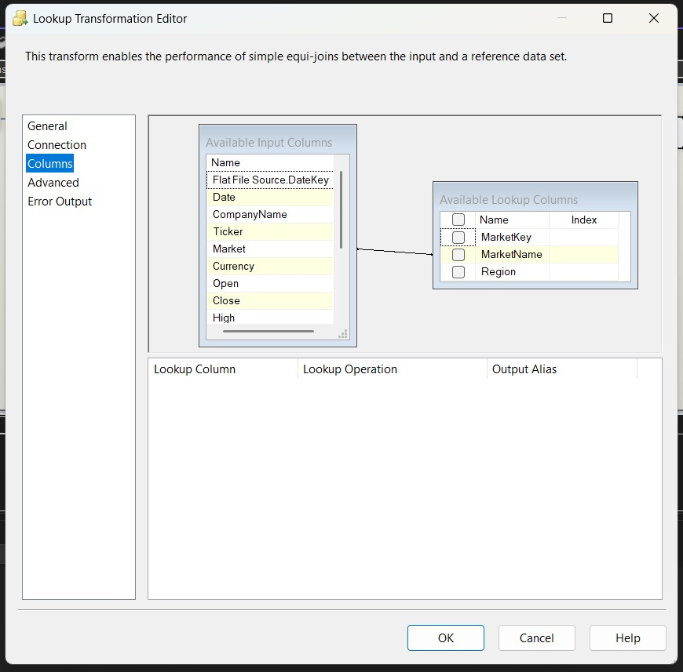

Slide 32
Graph DB(Neo4j) vs SQL DB
Aspect | Neo4j | SQL
Structure | Graph based structure | Table based
Best for | Highly connected data | Structured tabular data
Flexibility | Schema-less | Schema-based
Language | Cypher | SQL
Learning curve | Moderate for SQL users | Widely known
Applications | Social media, Market | Financial Applications
Integration | Compatible with modern stacks | Widely integrate ith all tech stacks

Slide 33
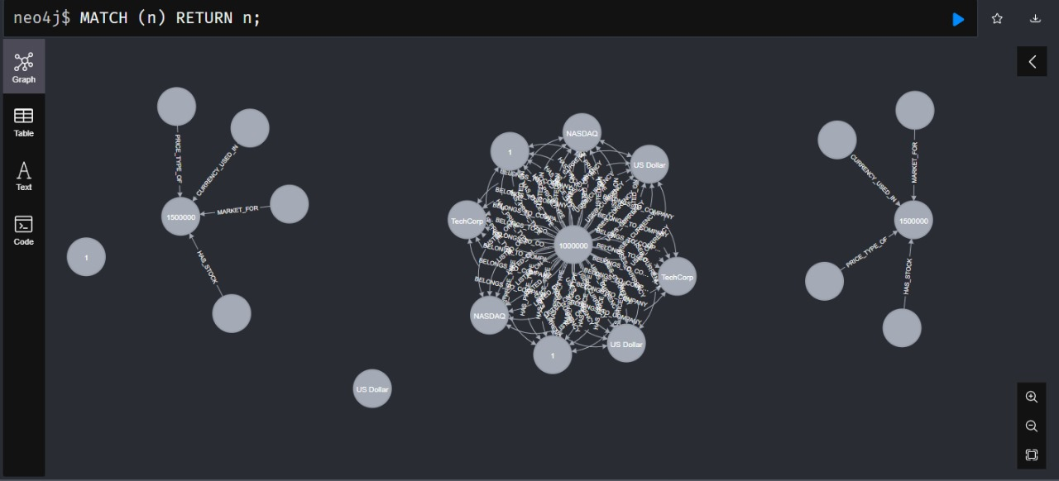
Graph model diagram (neo4j)

Slide 34
Finds each price node and the company it belongs to
Listing stock process and the currency used
Useful for understanding which stock exchange a company trades on
Shows a full relationship chain from price to company to its market
Filters by company and lists its stock process

Slide 35
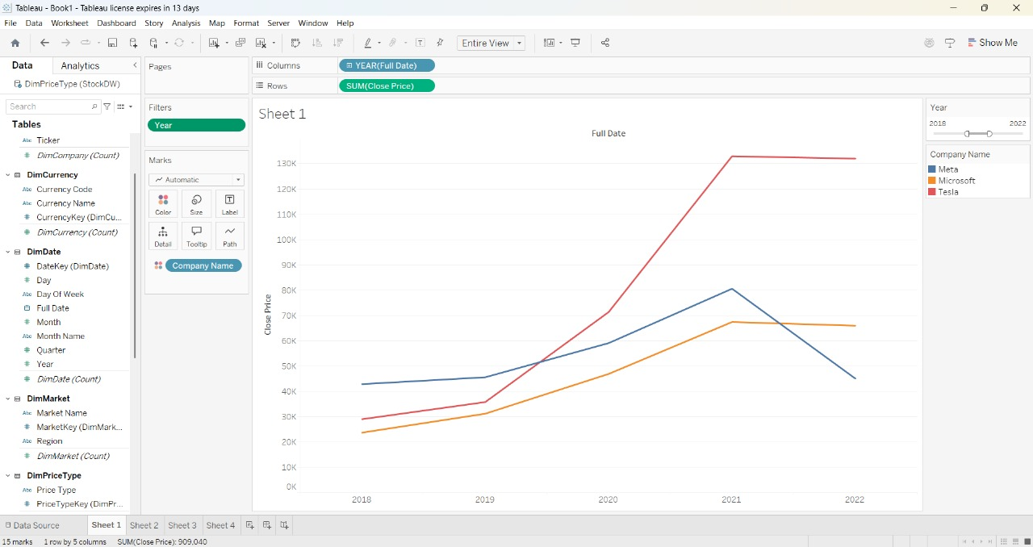
Stock Data Schema Overview

Slide 36
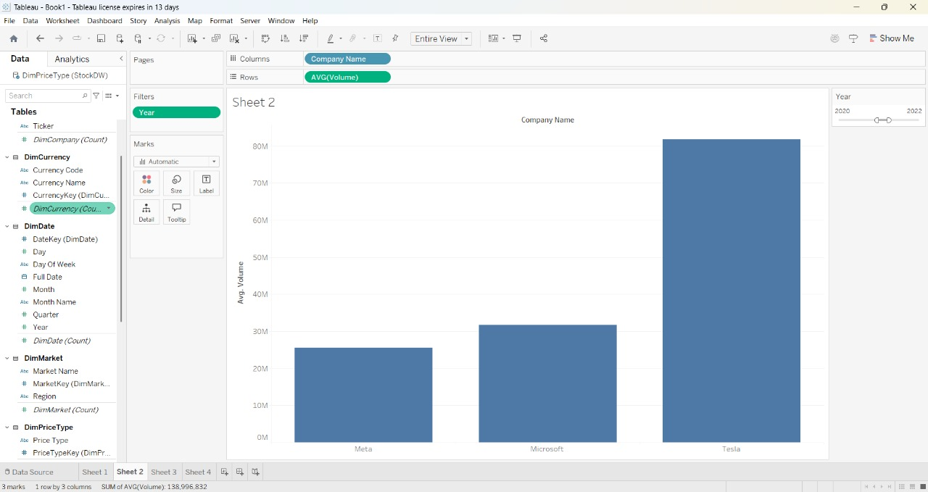
Company-wise Close Price Over Years

Slide 37
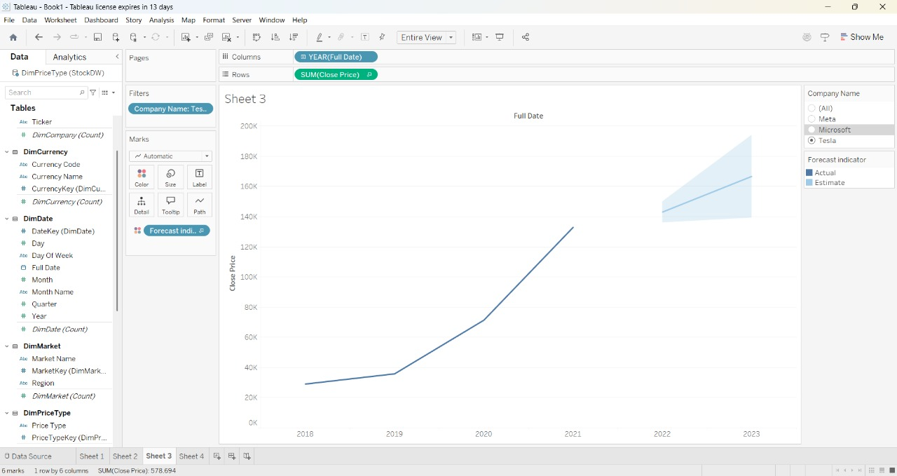
Average Trading Volume by Company (2020–2022)

Slide 38
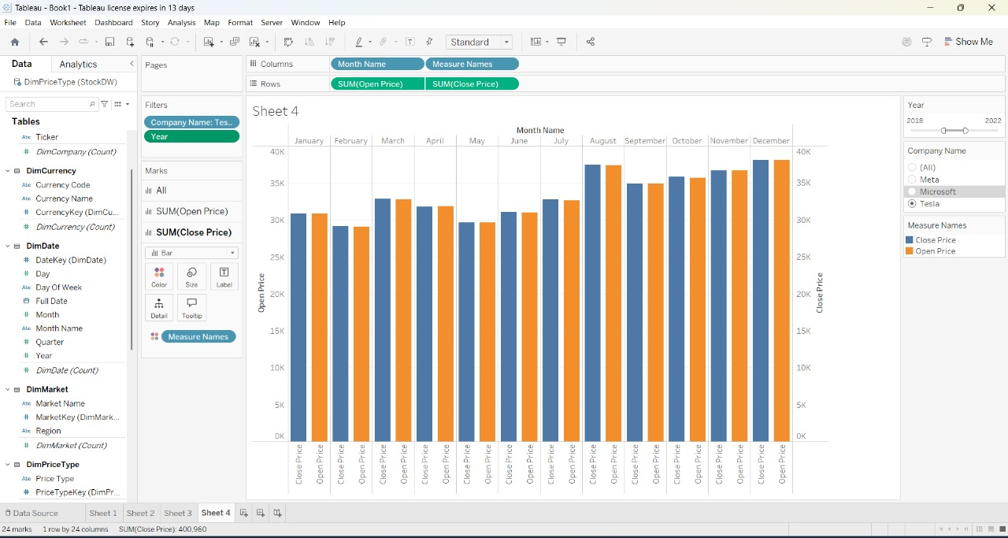
Close Price Trend Forecast for Tesla

Slide 39
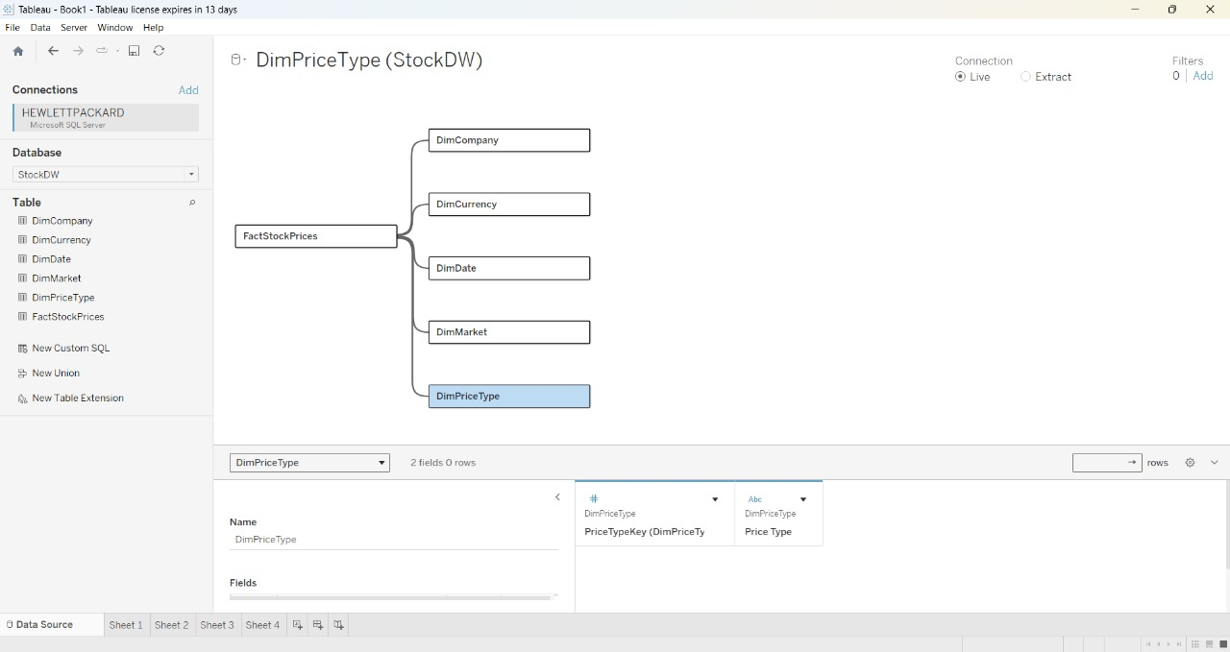
Monthly Open vs Close Price for Tesla

Slide 40
conclusion
ETL and Data Analytics Workflow Summary ETL Process – SSIS Extracted data from various source files, applied necessary transformations, and loaded the cleansed data into SQL Server databases. Data Modeling – SQL Server & SSMS Designed and implemented a star schema architecture with well-structured fact and dimension tables. Managed database schema, indexing strategies, and optimized SQL queries using SQL Server Management Studio (SSMS). Querying & Data Validation – SSMS Performed data validation and testing through SQL scripting. Conducted ad hoc analysis to ensure data accuracy and consistency. Operational Reporting – SSRS Developed static and parameter-driven reports for business operations, ensuring clarity and relevance for end users. Interactive Dashboards – Tableau Built interactive visual dashboards incorporating KPIs, filters, and visual insights for business stakeholders. Graph Analytics – Neo4j Modeled entities such as stock prices, currencies, and price type in Neo4j. Executed Cypher queries to uncover complex relationships and insights within the data graph.

